Slide 1
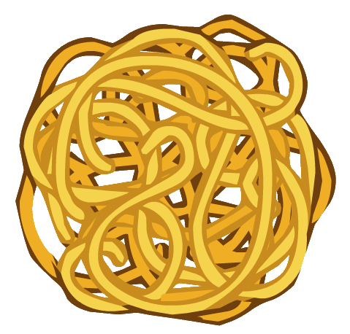

From spaghetti to reactive

Slide 2
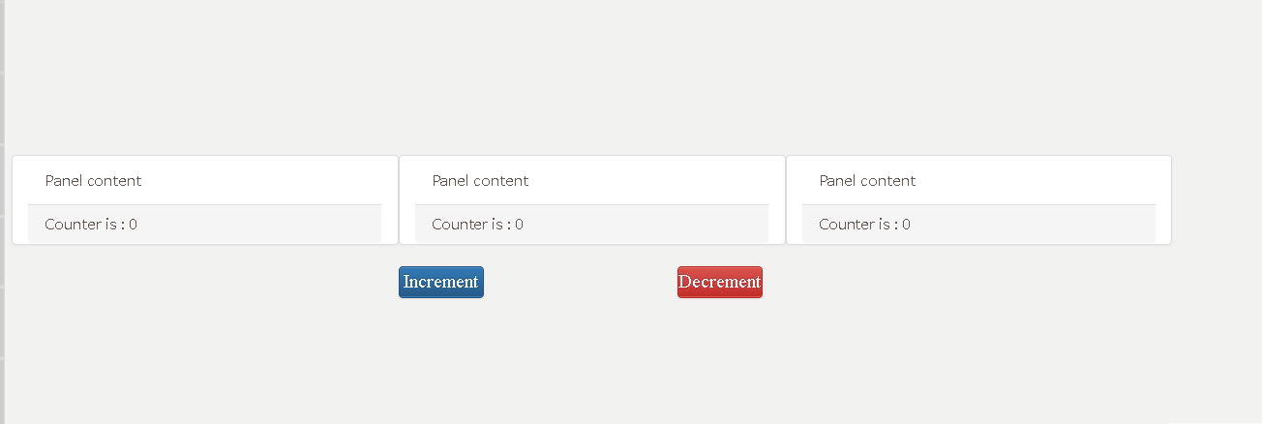
Let say we want to create this...

Slide 3
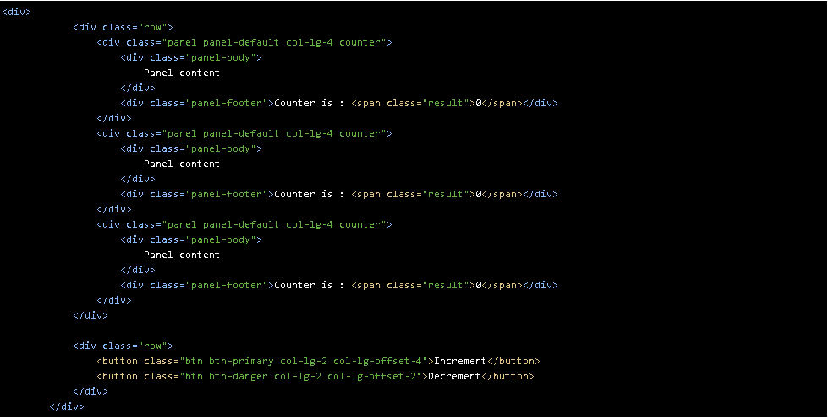
Let's go spagetti….. The HTML
Notes:
<div>
<div class="row">
<div class="panel panel-default col-lg-4 counter">
<div class="panel-body">
Panel content
</div>
<div class="panel-footer">
<div>
<label>By How Much?</label><input type="number">
</div>
Counter is : <span class="result">0</span>
</div>
</div>
<div class="panel panel-default col-lg-4 counter">
<div class="panel-body">
Panel content
</div>
<div class="panel-footer">
<div>
<label>By How Much?</label><input type="number">
</div>
Counter is : <span class="result">0</span>
</div>
</div>
<div class="panel panel-default col-lg-4 counter">
<div class="panel-body">
Panel content
</div>
<div class="panel-footer">
<div>
<label>By How Much?</label><input type="number">
</div>
Counter is : <span class="result">0</span>
</div>
</div>
</div>
<div class="row">
<button class="btn btn-primary col-lg-2 col-lg-offset-4 increment" >Increment</button>
<button class="btn btn-danger col-lg-2 col-lg-offset-2 decrement">Decrement</button>
</div>
</div>

Slide 4
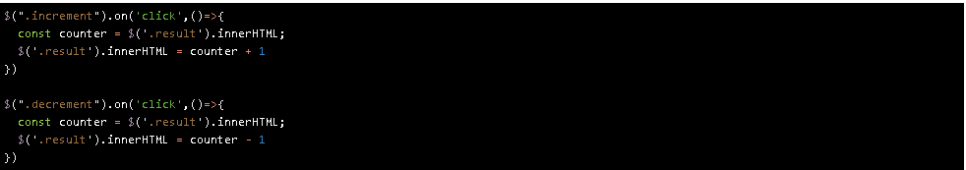
Let's go spaghetti in JQUERY
But!!!

Slide 5
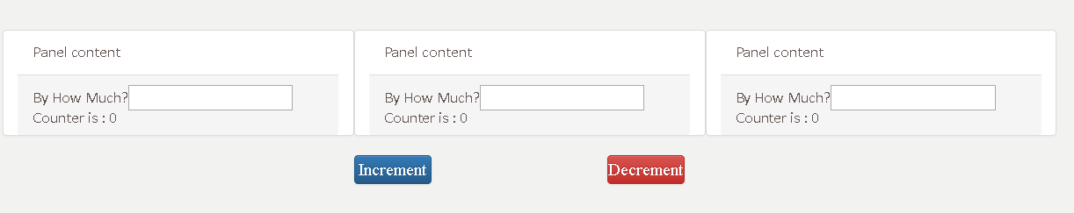
What if we want the user to decide how much to increment?

Slide 6
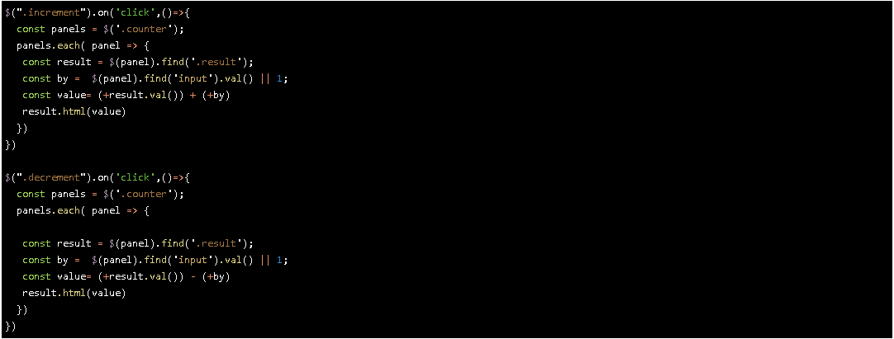
Let’s go spaghetti and do more

Slide 7
Spaghetti code can not be maintain!!!!
Likely for us,
Design pattern are for the rescue
Javascript main design patterns
Prototype
Factory
Module
Observable
Singleton

Slide 8
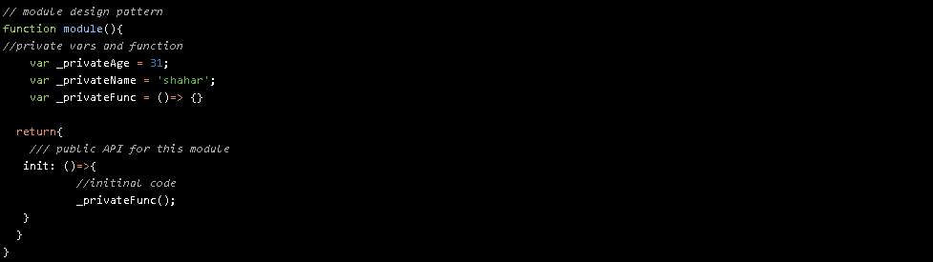
Let's go module pattern!

Slide 9
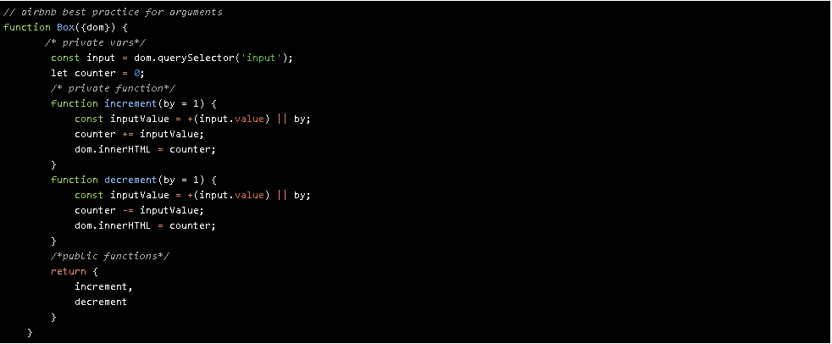
From Spaghetti to Module
Notes:
// airbnb best practice for arguments
function Box({dom}) {
/* private vars*/
const input = dom.querySelector('input');
let counter = 0;
/* private function*/
function increment(by = 1) {
const inputValue = +(input.value) || by;
counter += inputValue;
dom.innerHTML = counter;
}
function decrement(by = 1) {
const inputValue = +(input.value) || by;
counter -= inputValue;
dom.innerHTML = counter;
}
/*public functions*/
return {
increment,
decrement
}
}

Slide 10
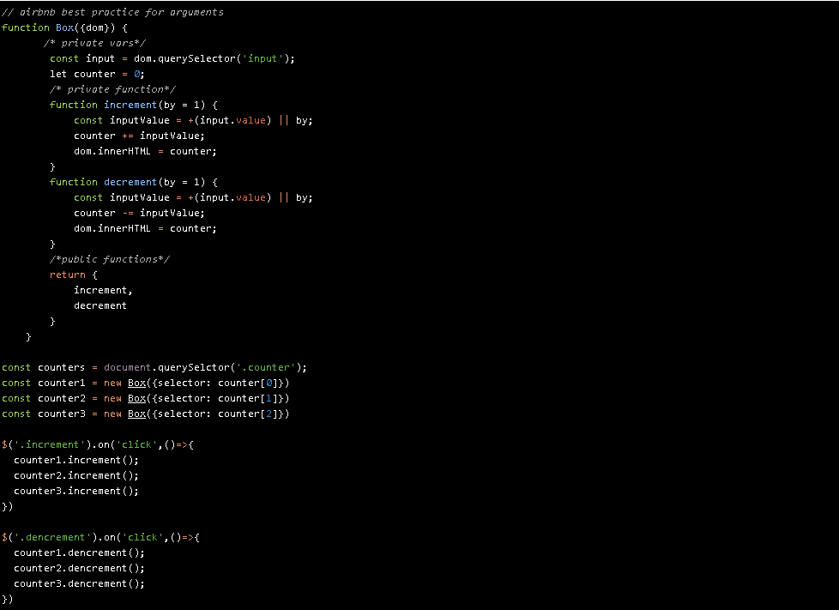
Let's use our module in the right way
Notes:
// airbnb best practice for arguments
function Box({dom}) {
/* private vars*/
const input = dom.querySelector('input');
let counter = 0;
/* private function*/
function increment(by = 1) {
const inputValue = +(input.value) || by;
counter += inputValue;
dom.innerHTML = counter;
}
function decrement(by = 1) {
const inputValue = +(input.value) || by;
counter -= inputValue;
dom.innerHTML = counter;
}
/*public functions*/
return {
increment,
decrement
}
}
const counters = document.querySelctor('.counter');
const counter1 = new Box({selector: counter[0]})
const counter2 = new Box({selector: counter[1]})
const counter3 = new Box({selector: counter[2]})
$('.increment').on('click',()=>{
counter1.increment();
counter2.increment();
counter3.increment();
})
$('.dencrement').on('click',()=>{
counter1.dencrement();
counter2.dencrement();
counter3.dencrement();
})

Slide 11
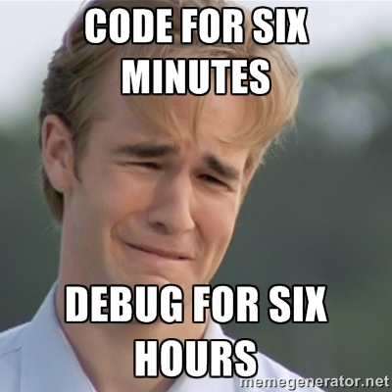
Houston,
we have a problem
To
Maintain
this

Slide 12


Let’s meet our friend,
Observable pattern. (Pub/Sub)

Slide 13
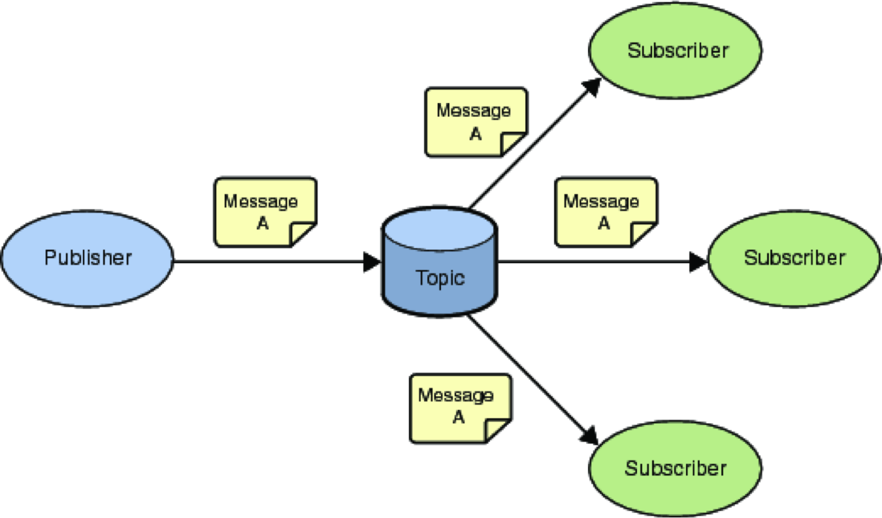
What is pub/ sub pattern
Like twitter
The celeb post his tweet
The subscriber get the push
Every publisher can have as many followers as he wants

Slide 14
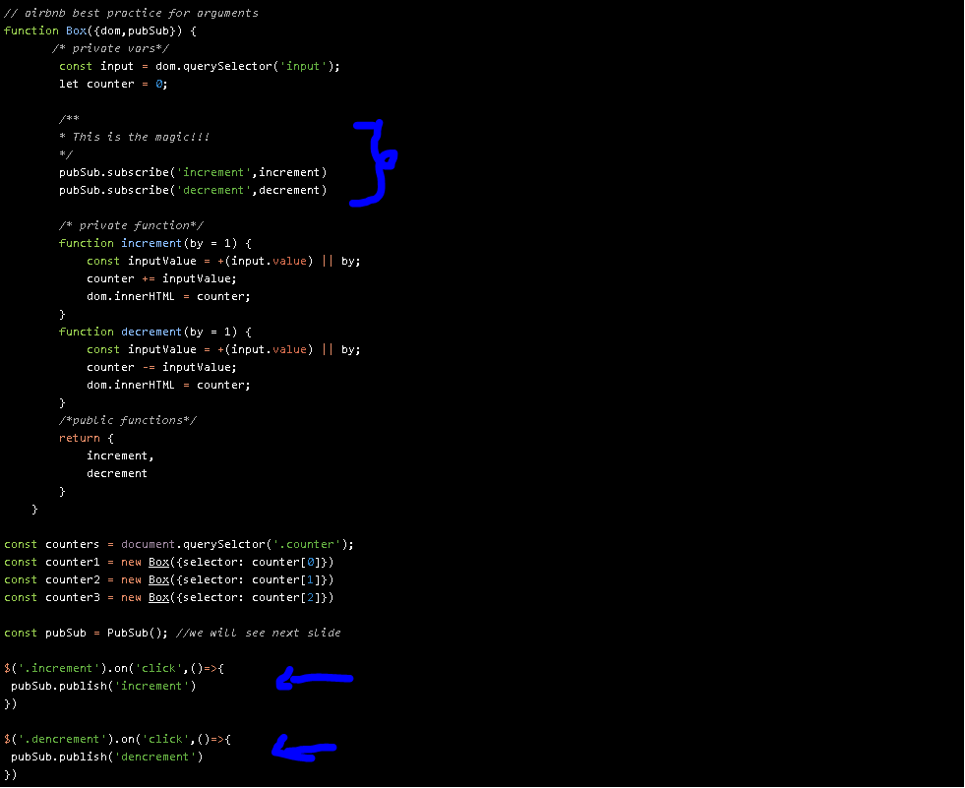
Let’s go pub/sub….

Slide 15
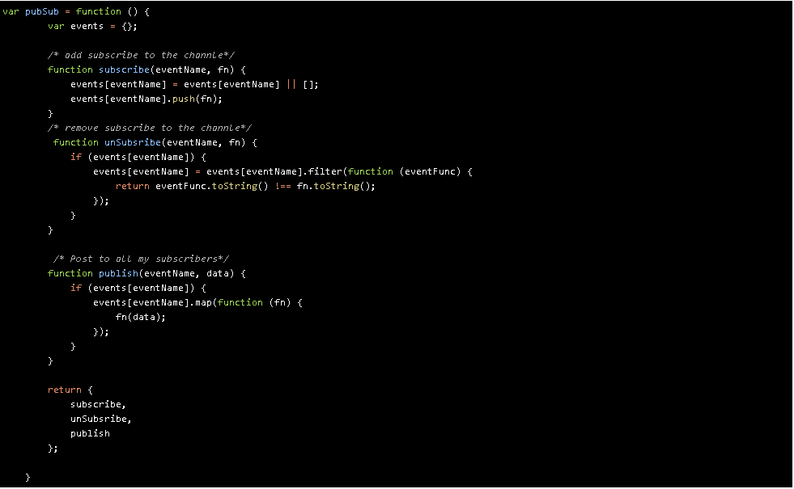
Show me the code.. (only 25 lines of code, with {})

Slide 16

What did i see right now...

Slide 17
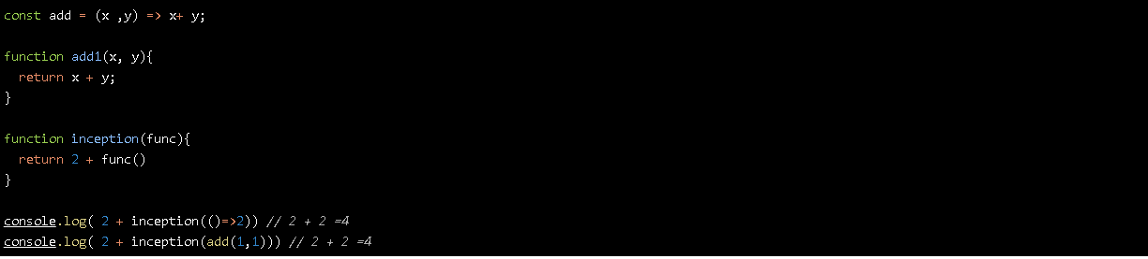
You passed function to array?!?!
You called function from array?!?!
WTF
In javascript, Everything is data. And functions are also pass as reference to there exist

Slide 18
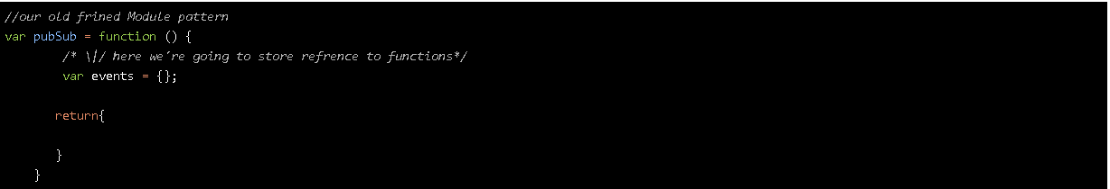
Let’s build from scratch
Hey, I know you
You are the module pattern

Slide 19
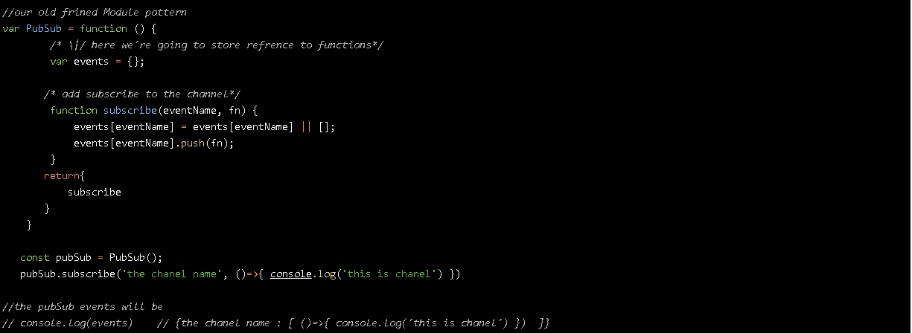
Let’s add some followers (subscribers)
With the method subscribe we will add function to the array of this channel
If the channel name is now exist we will create new array instance.
If he does, we will push to the stack the function reference
If not exist make new array instance as default

Slide 20
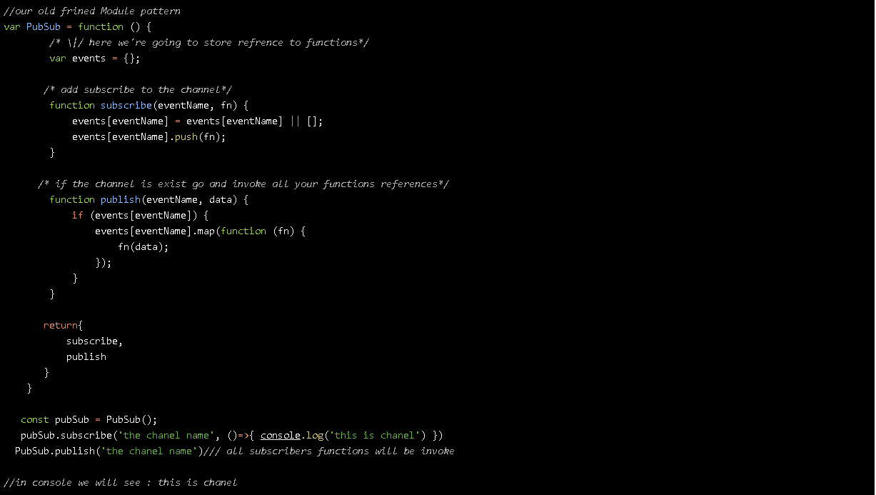
Let publish something to our followers
Event name and pass data to
The functions

Slide 21
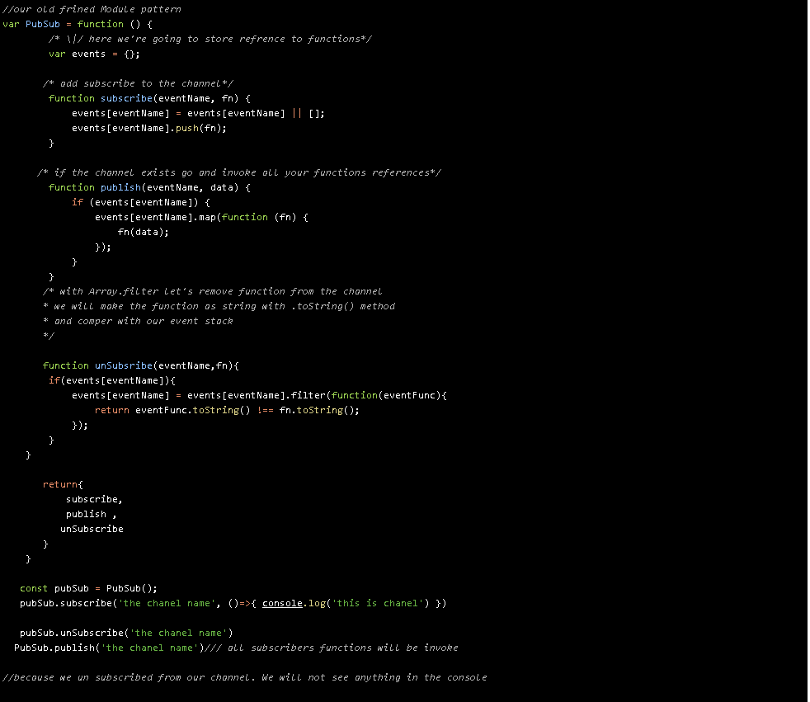
Let delete us from our publisher
Before anything published, and we unsubscribe
To the channel.
We will see nothing.

Slide 22
Wants next ?
Anything
With
x
Our evolution is RxJs
Angular NgJs
React Redux
Vue Veux
Reactive Programming

